Slide 1

Bubble Sort Algorithm Python Implementation

Slide 2
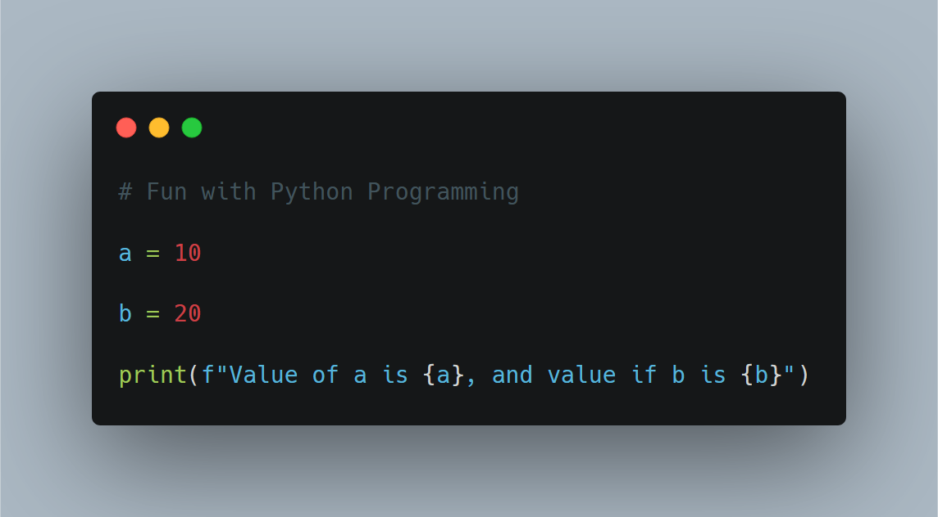
Some Fun with Python

Slide 3
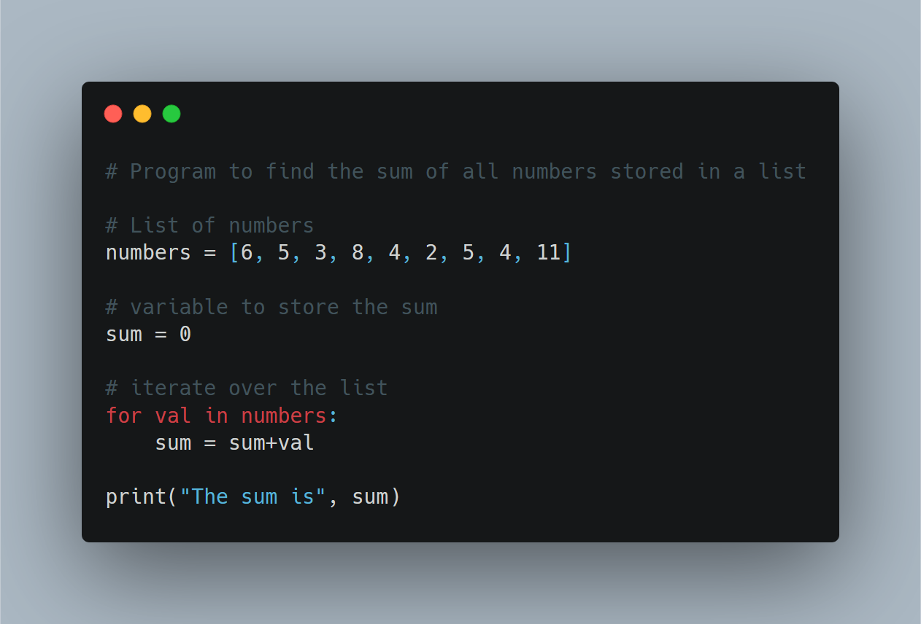
for loop

Slide 4
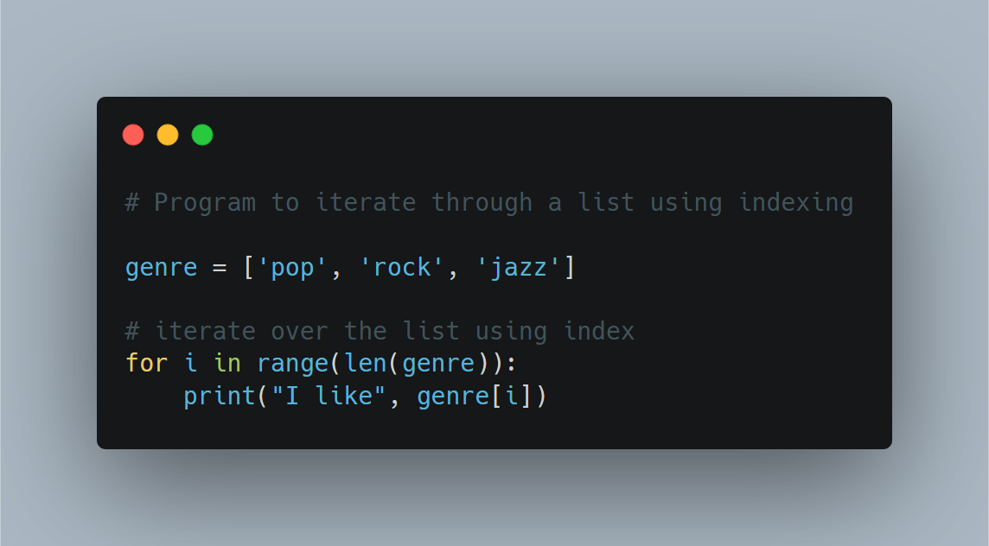
for loop

Slide 5
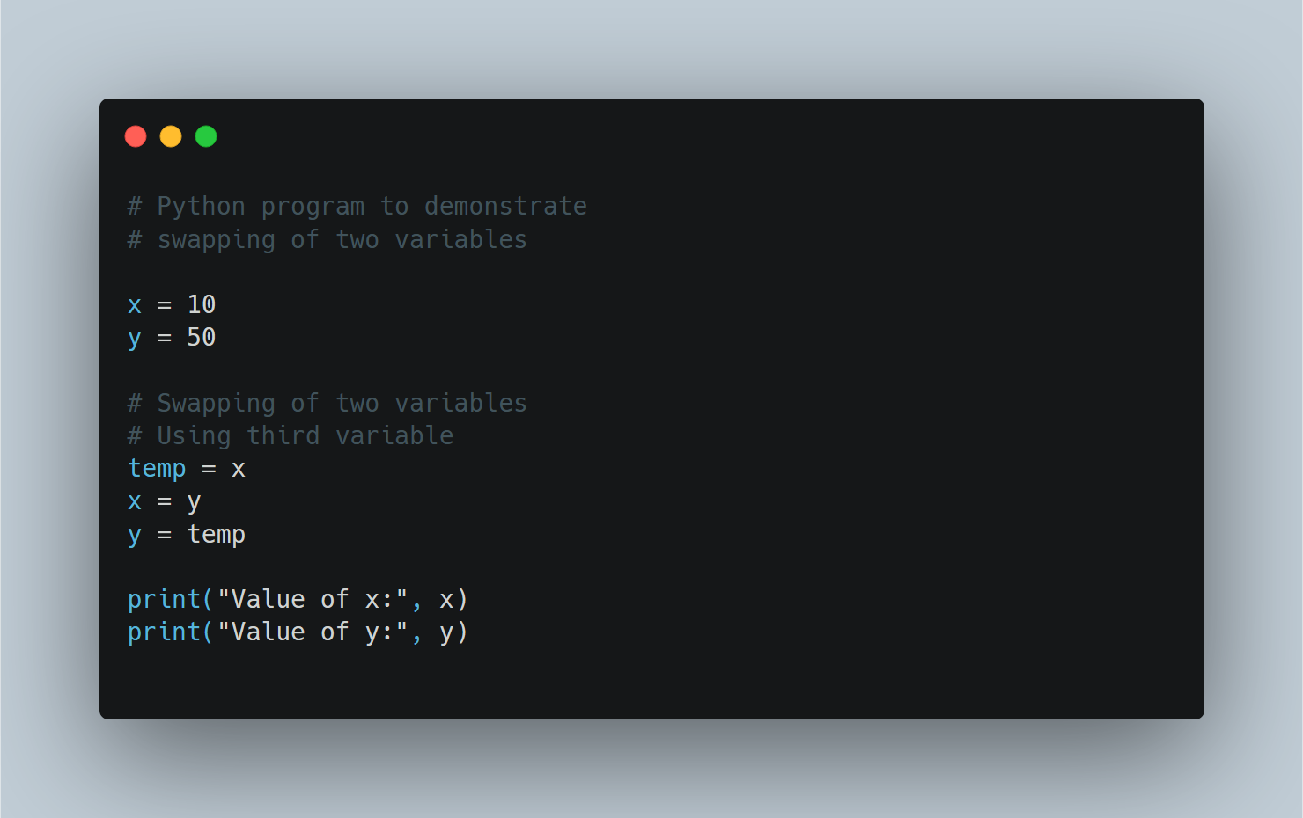
Swapping of Two Variables

Slide 6
SORTING WITH LIST
Sorting Algorithm is used to rearrange a given array or list elements according to a comparison operator on the elements.
Consider the list of 5 numbers – [9, 4,3,6,2]

Slide 7
a(5)
2
begin BubbleSort(list)
for all elements of list
if list[i] > list[i+1]
swap(list[i], list[i+1])
end if
end for
return list
end BubbleSort
6
a(4)
a(3)
3
a(2)
4
9
a(1)

Slide 8
Iteration Number
1
a(5)
2
6
a(4)
Position of Large Bubble
a (1)
Value
9
a(3)
3
SWAP
>
Iteration Number
1
a(2)
4
9
a(1)

Slide 9
Iteration Number
1
Iteration 1
a(5)
2
6
a(4)
SWAP
a(3)
3
a(2)
4
9
a(1)

Slide 10
Iteration Number
1
Iteration 1
a(5)
2
6
a(4)
SWAP
a(3)
3
9
a(2)
a(1)
4

Slide 11
Iteration Number
1
Iteration 1
a(5)
2
6
a(4)
9
SWAP
a(3)
a(2)
3
a(1)
4

Slide 12
Iteration Number
1
Iteration 1
a(5)
2
9
a(4)
6
SWAP
a(3)
a(2)
3
a(1)
4

Slide 13
Iteration Number
1
Iteration 1
9
a(5)
a(4)
2
6
a(3)
a(2)
3
a(1)
4

Slide 14
Iteration Number
2
Iteration 1
Iteration 2
9
9
a(5)
a(4)
2
2
6
6
SWAP
a(3)
a(2)
3
3
a(1)
4
4

Slide 15
Iteration Number
2
Iteration 1
Iteration 2
9
9
a(5)
a(4)
2
2
6
6
NO SWAP
a(3)
a(2)
3
4
a(1)
4
3

Slide 16
Iteration Number
2
Iteration 1
Iteration 2
9
9
a(5)
a(4)
2
2
6
6
SWAP
a(3)
a(2)
3
4
a(1)
4
3

Slide 17
Iteration Number
2
Iteration 1
Iteration 2
9
9
a(5)
a(4)
6
2
6
a(3)
2
a(2)
3
4
a(1)
4
3

Slide 18
Iteration Number
3
Iteration 1
Iteration 2
Iteration 3
9
9
9
a(5)
a(4)
6
6
2
6
NO SWAP
a(3)
2
2
a(2)
3
4
4
a(1)
4
3
3

Slide 19
Iteration Number
3
Iteration 1
Iteration 2
Iteration 3
9
9
9
a(5)
a(4)
6
6
2
6
SWAP
a(3)
2
2
a(2)
3
4
4
a(1)
4
3
3

Slide 20
Iteration Number
3
Iteration 1
Iteration 2
Iteration 3
9
9
9
a(5)
a(4)
6
6
2
6
4
a(3)
2
a(2)
3
4
2
a(1)
4
3
3

Slide 21
Iteration Number
4
Iteration 1
Iteration 2
Iteration 3
Iteration 4
9
9
9
9
a(5)
a(4)
6
6
6
2
6
4
4
SWAP
a(3)
2
a(2)
3
4
2
2
a(1)
4
3
3
3

Slide 22
Iteration Number
4
Iteration 1
Iteration 2
Iteration 3
Iteration 4
9
9
9
9
a(5)
a(4)
6
6
6
2
6
4
4
a(3)
2
a(2)
3
4
2
3
a(1)
4
3
3
2

Slide 23
Position of the value
Iteration 1
Iteration 2
Iteration 3
Iteration 4
9
9
9
9
Iteration Number
a(5)
a(4)
6
6
6
2
6
4
4
Sorted List
a(3)
2
a(2)
3
4
2
3
a(1)
4
3
3
2

Slide 24
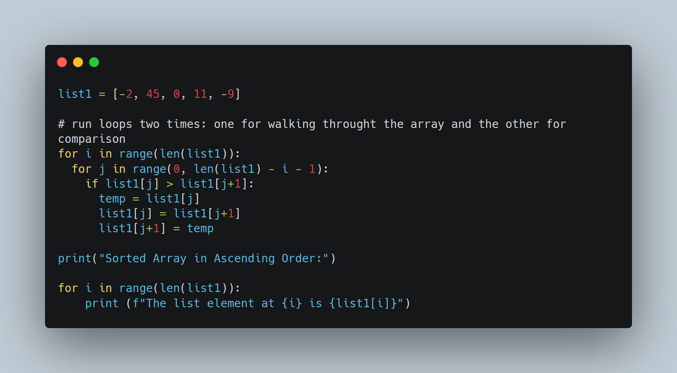
Python Program for Bubble Sort Implementation – 1
Remember, list index will start with ‘0’

Slide 25
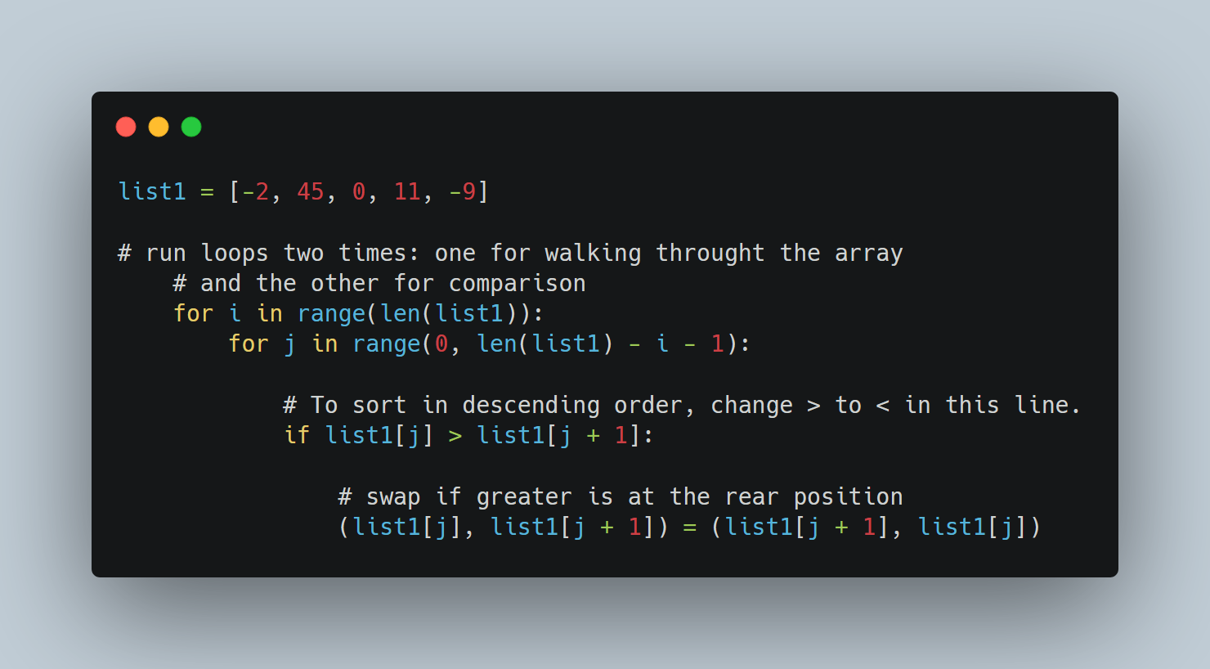
Python Program for Bubble Sort Implementation – 2

Slide 26
Group Task
Write a python program to print all the alphabets in your letter in an ascending order
What is list?
Collection of elements
Every element in a list can be accessed separately
my_name = [‘shivranjan’]
my_name = [‘s’, ‘h’, ’i’, ’v’]

Slide 27
